Slide 1
Academic Reading & Writing
Unit 3: Dictionary Use and Vocabulary Choices in L2 Writing
Literature Reviews

Slide 2
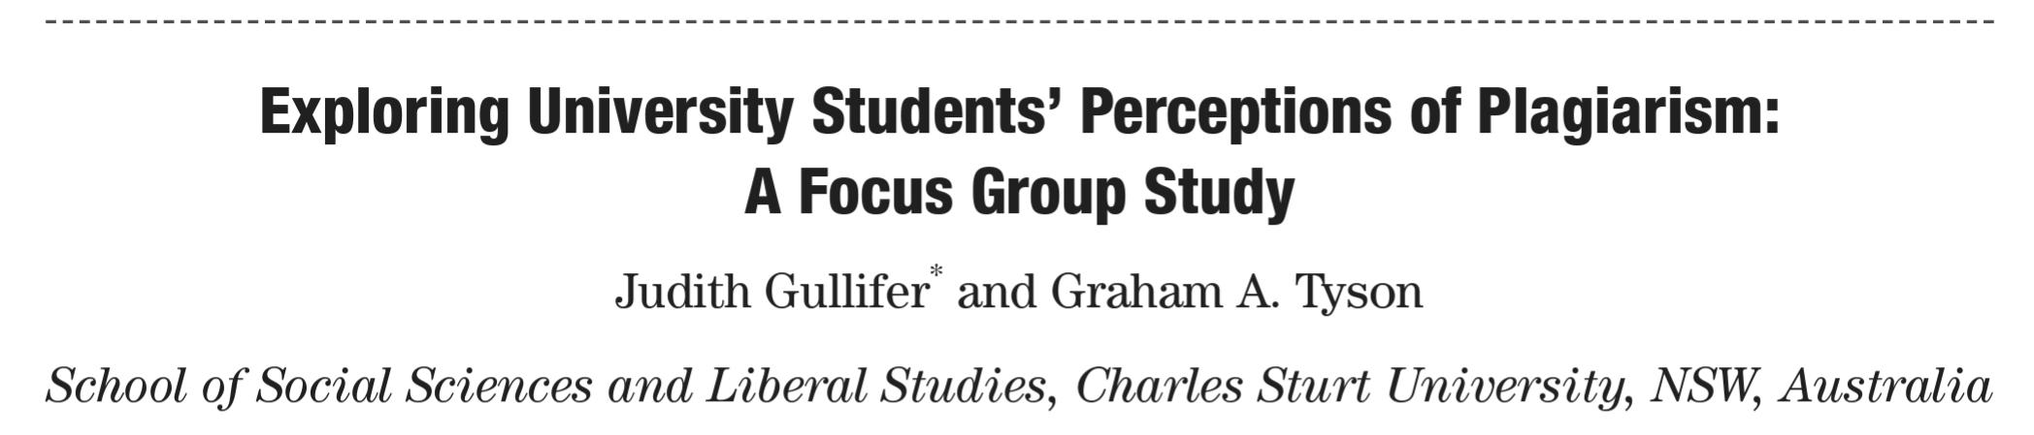
Last Week
We finished Unit 1
We looked at the major sections of an example research paper, and tried to figure out the mechanics of language and structure in it

Slide 3
Page 32/33 – Task Two
On Page 32/33, there are eight sentences from a research paper entitled “Studying in a Second Language: the Experiences of Chinese Students in Canada”. Based on your knowledge, can you guess from which of the sections they come?
Mark each one I, M, R, D. There are two sentences from each section.

Slide 4
In contrast, subjects in the text absent condition of Study 2 appeared to apply planning and organizational strategies more directly. _____
Similarly, Yee (1989) reported that Asian university students commonly respond to the intense pressure for academic achievement by adopting memorization strategies, and this may be particularly true for such students in English-speaking universities. _______
This supports the argument made earlier in this paper that a reasonable level of fluency provides a basis for higher level processes.______
The text used in Study 2 consisted of a five-page article about nurses’ management of children’s pain, typical of texts read in an undergraduate course; no glossary was provided. ________

Slide 5
However, several patterns were apparent in the results and these deserve some comments. ________
It is now common for students from virtually every country in the world to either study English at home, or to study abroad in an English-speaking country. _______
Not only did subjects in Study 1 appear heavily dependent on the overall structure of the text, they also were reliant in the way it expressed ideas. _________
The students selected were adult, native-Chinese speakers from mainland China, studying in Canada. ______

Slide 6
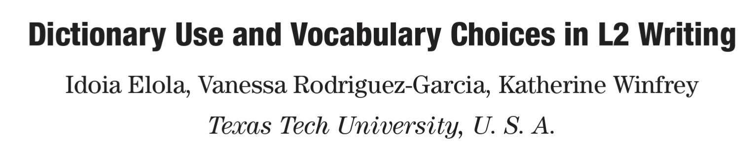
This Unit’s Reading
Our goal today is to get an understanding of the topic, and then go through the literature review in detail
The unit’s focus is Literature Reviews

Slide 7
Introduction

Slide 8
The burgeoning use of online dictionaries reflects the worldwide population’s need to access multiple lexical sources rapidly. Language learners, who are generally technologically well informed, are motivated to tap into these resources and take an active approach toward their learning. However, regardless of the accessibility of these online tools, most can probably recount anecdotes about learners’ misuse of the dictionary, both in oral and written productions. […] Learners’ inability to use this tool effectively stems from a lack of knowledge of how the L1 and L2 mental lexicon functions as well as a lack of familiarity with the dictionary itself.
Page 72

Slide 9
At present, the majority of the research studies related to dictionary use have focused on its relationship to L2 reading, such as the use of bilingual or monolingual dictionaries, dictionary use versus glossaries, and the impact of dictionary use on the learners’ reading processes. Although this body of research offers insights into learners’ behavior in relation to dictionary use, it is also essential to observe students’ ability to use the dictionary as a tool for written production and to teach them to use it more effectively. […]
Page 72

Slide 10
[…] It is important, as Scholfield (1982) suggested, to view the use of a dictionary not as a straightforward technical and passive activity, but rather as a complex process of hypothesis testing that involves the active participation of the learner. Within the realm of L2 writing, this article explores issues of dictionary use in relation to foreign language (FL) writing, more specifically in terms of Spanish.
Page 72

Slide 11
Questions
What is the research topic of this paper?
Why is this topic worth studying?
What are some issues the authors want to study?

Slide 12
Literature Review
We will see this section in the most detail – this is our focus for this unit

Slide 13
1
Research in the field of vocabulary acquisition and learning has shown the advantage of equipping learners with specific strategies to enhance and further the learner’s lexical acquisition process. Several taxonomies have included dictionary use as an important learning strategy (Oxford, 1990; Gu & Johnson, 1996; Schmitt, 1997; Nation, 2001). Gu and Johnson (1996) and Schmitt (1997) consider dictionary use as a cognitive strategy that occurs in conjunction with guessing and note-taking strategies. Similarly, Nation’s division (2001) of strategies describes dictionary use as a source strategy that provides information about a specific item.
Page 72/73

Slide 14
2
Furthermore, studies on the use of vocabulary strategies have revealed that active strategy users are more successful vocabulary learners than those learners with a poor knowledge of strategy use, emphasizing the need to provide learners with conscious strategies (Ellis, 1994; Sanaoui, 1995; Lawson & Hogben, 1996; Chamot, 2001; Fan, 2003; Gu, 2005; Macaro, 2005; Peters, 2007). Moreover, most studies conducted on the use of dictionaries as a vocabulary learning strategy conclude that dictionary use has a positive influence on the learner’s acquisition process (Hulstijn, 1993; Luppescu & Day, 1993; Knight, 1994; Jones, 1995; Laufer & Hadar, 1997; Bruton & Broca, 1997, 2004; Laufer & Hill, 2000; Bruton, 2007). […]
Page 73

Slide 15
[…] Primarily, research on dictionary use has focused on exploring the benefits of monolingual (Ard, 1982; Scholfield, 1982; Meara & English, 1987; Thompson, 1987; Hartmann, 1991; Summers, 1995) and/or bilingual dictionaries (Baxter, 1980; Laufer & Hadar, 1997; Asher, Chambers & Hall, 1999; Barnes, Hunt & Powell, 1999; Bishop, 1998, 2000; Tall & Hurnam, 2000). Studies have also discussed learners’ intentions when consulting dictionaries, namely checking spelling, gender and word meaning (Bishop, 1998, 2000), or searching for additional grammatical, phonological and pragmatic information (Cano Ginés, 2004). However, researchers have also realized that the effectiveness of vocabulary learning strategies depends on the type of task, the learner’s preferences, personal characteristics, and the learning context (Williams & Burdens, 1997; Cohen, 1998, 2001; Gu, 2003).
2
Page 73

Slide 16
3
One limitation in the use of the dictionary stems from the learner’s inability to separate lexical and semantic meanings. From a psychological perspective, as Vygotsky (1978) noted, the mind is related to the social context, and since language is related to the mind, language consequently depends on the social context. Vygotsky divides linguistic development into three stages: the object-regulation stage (learner’s language ability is controlled by the object); the other-regulation stage (learner is influenced by others in making his/her linguistic choices); and the self-regulation stage (learners are able to control their own lexical choices). […]
Page 73

Slide 17

CAT
FELINE
KITTY

Slide 18
3
[…] When applied to dictionary use and vocabulary choice, learners appear to follow the same stages of regulation; it is not until the self-regulation stage that they develop their semantic knowledge (Lantolf; Labarca, & den Tuinder, 1985; Jiang, 2004). Studies indicate that semantic development is a slow process in which L2 learners learn a word at the lexical level and then at the semantic level. Hence, L2 learners need to have an idea of the form and meaning of the word in their L1 in order to find its equivalent in their L2 in a dictionary. […]
Page 73

Slide 19
3
[…] Thus, a learner’s specific stage of development influences the types of strategies used when looking up words: at a lower level of development, a learner will only be able to apply a lexical strategy, whereas at a more advanced level, a learner will engage in semantic lookup strategies (Hartmann, 1983; Laufer & Hadar, 1997). Different stages of development also make certain grammatical categories more difficult to acquire, such as prose words, domain-specific words, and inflectional words (González,1999).
Page 73/74

Slide 20
4
Apart from L2 proficiency limitations, certain learners are unable to perform a successful search due to their inability to use the dictionary correctly. Christianson (1997) indicates that successful FL dictionary users, regardless of their level of English proficiency, are able to employ more sophisticated lookup strategies. Dictionary users may benefit from using efficient dictionary strategies (Graves, 1987; Summers, 1988), attending to all of the information in an entry before making conclusions about the meaning of a word (Laufer & Hadar, 1997; Hunt & Beglar, 1998), working with activities in which vocabulary is practiced in various contexts (Schmitt, 1997), and from being instructed not to take the first word that appears in the entry in the dictionary, so as to reduce the notion of a one-to-one equivalency between their L1 and L2 (Barbe, 2001).
Page 74

Slide 21
5
Finally, it is important to note that new technological and computer developments have facilitated learning with tools such as electronic and online dictionaries, online translators, and thesaurus features available in Microsoft Word. The advantages that these new technologies offer to learners, teachers and researchers include: electronic dictionaries with multimedia annotations (Chun & Plass, 1996; Hulstijn, Hollander, & Greidanus, 1996), computer logs, trackers of learner behavior and online vocabulary glosses (Gu, 2003), and interactivity, hypertextuality, quick access, and multimedia effects, as well as other extra features such as video, audio materials, corpus examples, interactive exercises, and games (Pérez Tortes & Sáinchez Ramos, 2003). Most studies about electronic dictionary use have offered similar conclusions to those of studies on traditional dictionaries (Aust, 1993; Knight, 1994; Segler, 2002; Hill & Laufer, 2003; Pérez Torres & Sánchez Ramos, 2003; Fan, 2003; Loucky, 2005; Brnton, 2007; Peters, 2007).
Page 74

Slide 22
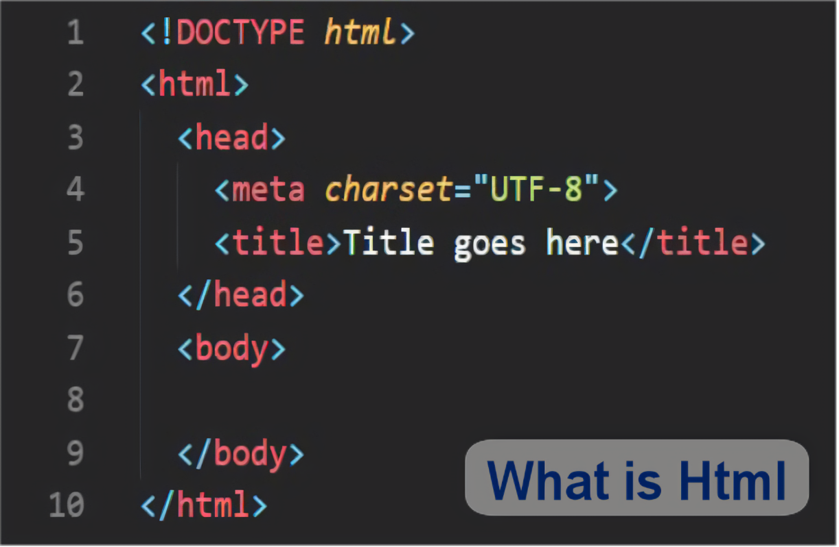
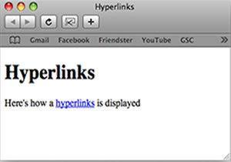
Hypertext Markup Language (HTML)

Slide 23
6
Nevertheless, within the realm of online dictionary research, this article intends to further investigate issues and concerns about learners’ inability to use online dictionaries effectively, select the correct information about certain words and employ strategies to search successfully for the appropriate meaning of the word. Although the overarching aim was to understand how learners use online dictionaries for L2 writing purposes, this idea was further explored in the following questions:
Page 74

Slide 24
6
[…]
In what instances do FL learners consult online dictionaries while writing in Spanish?
What kinds of lexical items are problematic for FL learners while using online dictionaries?
What strategies do FL learners employ in their search for the appropriate meaning of lexical items?
Furthermore, this article presents some pedagogical suggestions for online dictionary use that can be incorporated in L2 classrooms.
Page 74/75

Slide 25
Questions
How did the researchers synthesize the previous research in this paper?
Is the literature review just a summary of the sources? Why or why not?
What is their progression of paragraph topics?

Slide 26
Vocabulary Practice (Pg. 89-90)
Match the Word to the Definition

Slide 27
Column A | Column B
Essential | very different from each other
Overview | of or relating to items of vocabulary in a language
Diverse | an occasion when you meet or experience something
Encounter | extremely important and necessary
Implication | a note added in explanation to a piece of writing
Semantic | a record of data or observations on a particular experiment
Lexical | to confirm or support
Annotation | relating to the meanings of words
Protocol | a general survey
Corroborate | a possible future effect or result of an action, event, etc

Slide 28
Next Week
Go through how to write a literature review and use citations
Unit 3 Quiz (Same format as last time)

